Slide 1
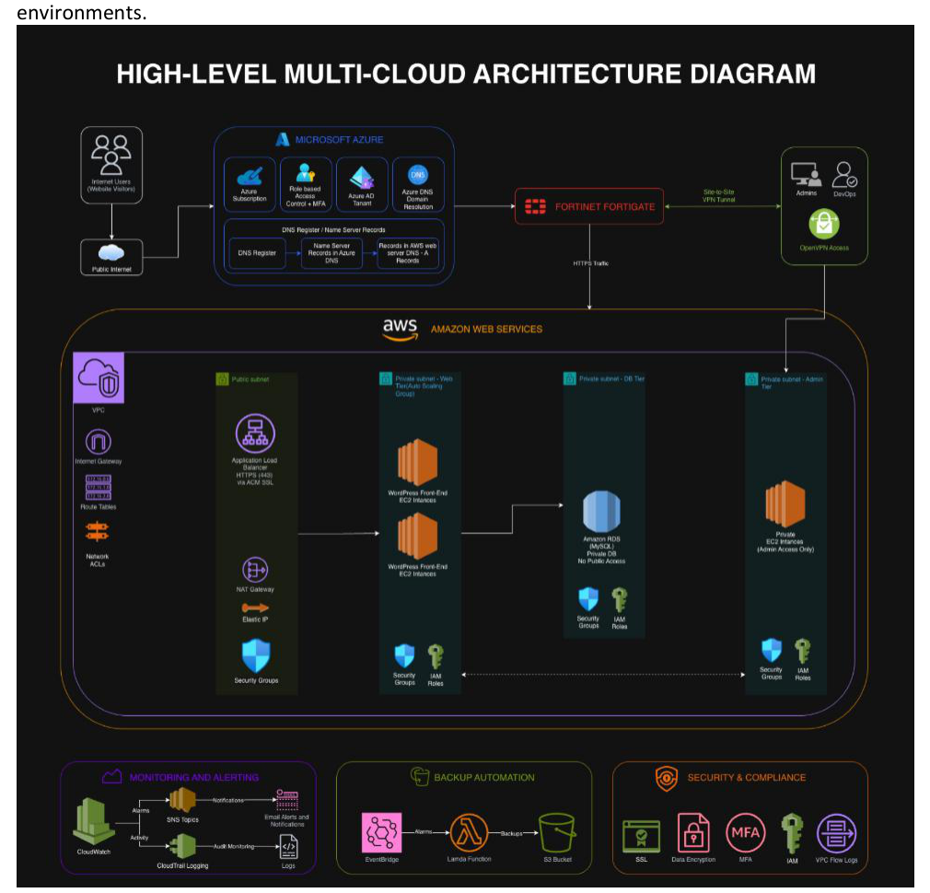
Multi-Cloud Security Integration
and Project Management
Geni Bahar • Yusof Sharifzai • Hari Tamang
Student_Group_01-FT
CCC604 Assessment 8 | Multi-Cloud Security Integration | 1
Notes:
Opening (Yusof/Hari, 45 seconds): Welcome the audience and introduce the project. Explain that this presentation is the final recorded presentation for Assessment 8. Mention the team members and that the project migrated a WordPress infrastructure into a secure multi-cloud design using AWS, Azure and Fortinet.

Slide 2
Presentation roadmap
Agenda
Designed for a 30-minute recorded team presentation
PART 1: PROJECT AND TEAM
PART 2: IMPLEMENTATION AND SECURITY
Project scenario and goals
Team roles and communication plan
High-level multi-cloud architecture
AWS hosting, monitoring and backup
Azure identity, DNS and testing
Fortinet, VPN and firewall integration
Risk, incident handling and final verification
Suggested speaking split: Geni 13–15 min • Yusof 7–8 min • Hari 6–7 min
CCC604 Assessment 8 | Multi-Cloud Security Integration | 2
Notes:
Yusof/Hari, 45 seconds: Walk through the flow of the presentation. Emphasise that the structure follows the assignment phases, but the language will be presented as a project journey. State that the timing keeps the video close to 30 minutes.

Slide 3
Project scenario
Project overview
Yoobee WordPress migration into a secure multi-cloud design
Existing WordPress infrastructure needed better security, availability and monitoring
AWS was selected for the main workload hosting layer
Azure supported identity, RBAC/MFA, DNS and access testing
Fortinet FortiGate provided firewall/VPN security controls between environments
CCC604 Assessment 8 | Multi-Cloud Security Integration | 3
Notes:
Yusof/Hari, 1 minute: Describe the scenario in plain language. The project was to plan and demonstrate a secure migration of a WordPress environment. AWS hosts the main workload, Azure supports identity and DNS, and FortiGate is included as the security layer.

Slide 4
Project goals and success criteria
Project overview
What we needed to prove by the end of the project
1
2
3
4
Secure workload hosting
Multi-cloud integration
Risk + incident handling
Final verification
Functional WordPress application with database back end
Separate public/private network design with controlled access
Monitoring, notification, backup and HTTPS evidence
Clear risk assessment and incident analysis based on project testing
CCC604 Assessment 8 | Multi-Cloud Security Integration | 4
Notes:
Yusof/Hari, 1 minute: Explain that success was not just deploying resources. The team needed to show security, integration, testing and documentation. This slide gives the marker a simple way to see what “done” means for the project.

Slide 5
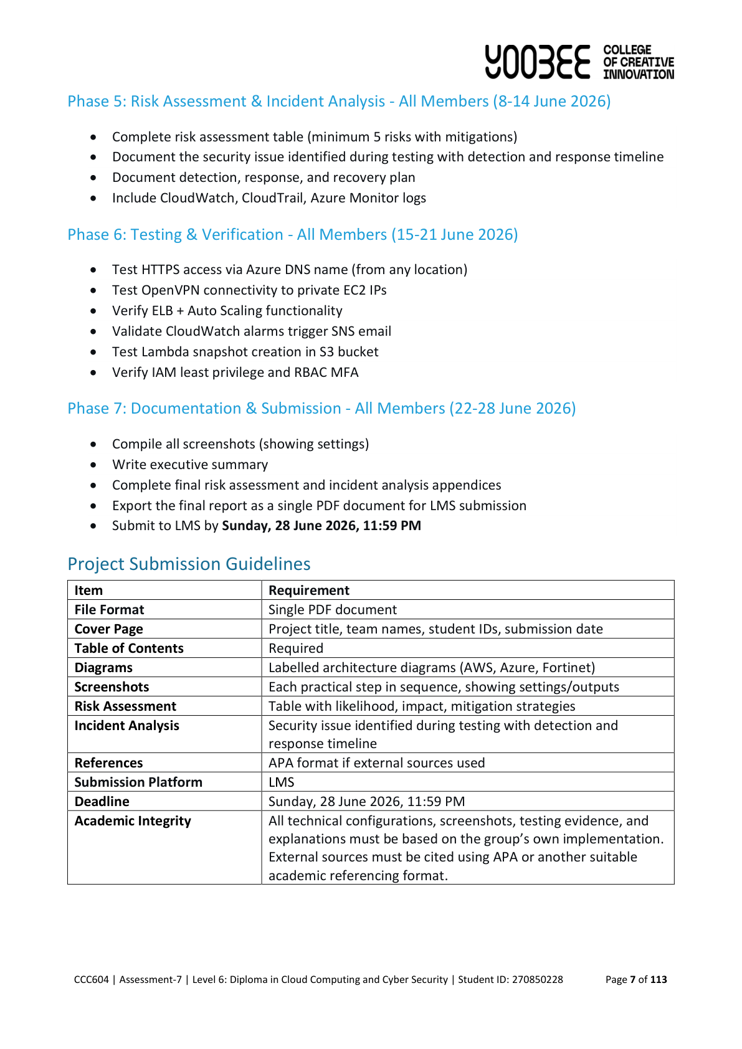
Team roles and responsibilities
Task 1
Each member owned a clear part of the project
GENI BAHAR
YUSOF SHARIFZAI
HARI TAMANG
AWS implementation lead
FortiGate/VPN integration support
Risk and security evidence
Azure implementation lead
RBAC/MFA, Azure AD and DNS
HTTPS/VPN testing evidence
Project coordination support
Testing and screenshot collection
Incident analysis support
CCC604 Assessment 8 | Multi-Cloud Security Integration | 5
Notes:
Yusof/Hari, 1 minute: Explain the role split. Mention that the team did not work as isolated individuals; the split helped accountability, while final checking and testing were shared. This slide is important because Assessment 8 gives 50% to team communication.

Slide 6
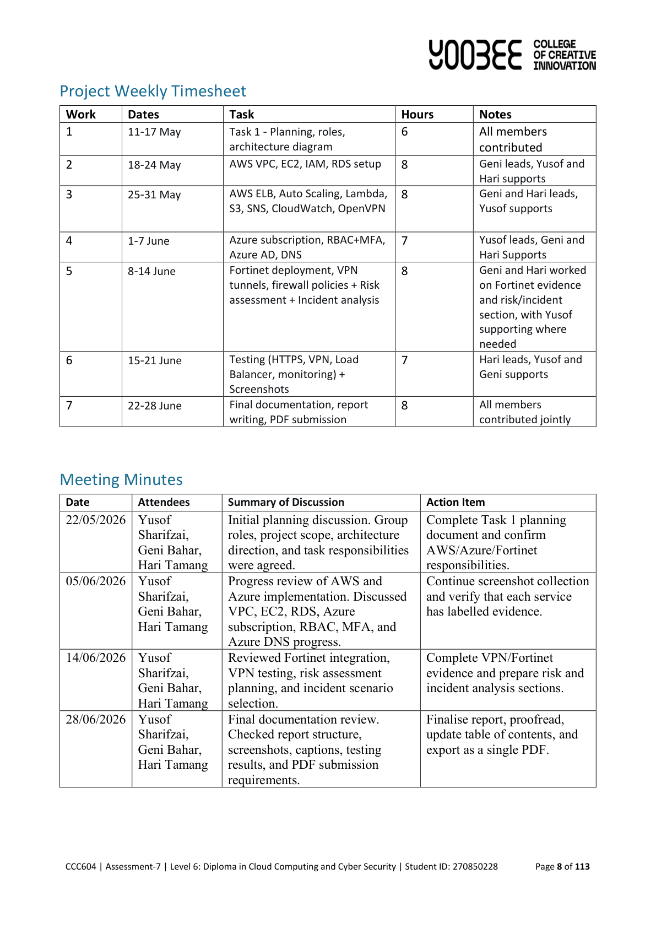
Team communication plan
Task 1
How we coordinated work and kept the project moving
Weekly planning and progress check-ins
Tasks split by AWS, Azure, Fortinet, testing and documentation
Shared screenshots and documentation evidence for final reporting
Issues escalated early so blockers did not stop the project
CCC604 Assessment 8 | Multi-Cloud Security Integration | 6
Notes:
Yusof/Hari, 1 minute: Talk through how the group communicated. Mention meetings, shared documents, screenshot collection and final review. Keep it practical: the aim was to avoid duplicate work and make sure each member knew their part.

Slide 7
Architecture overview
Design
How AWS, Azure and Fortinet worked together
CCC604 Assessment 8 | Multi-Cloud Security Integration | 7
Notes:
Geni, 1.2 minutes: Use the architecture diagram as the main visual. Explain the boundaries: AWS workload hosting, Azure identity and DNS, FortiGate as firewall/VPN security component. Point out public and private areas and explain why the database should not be public.

Slide 8
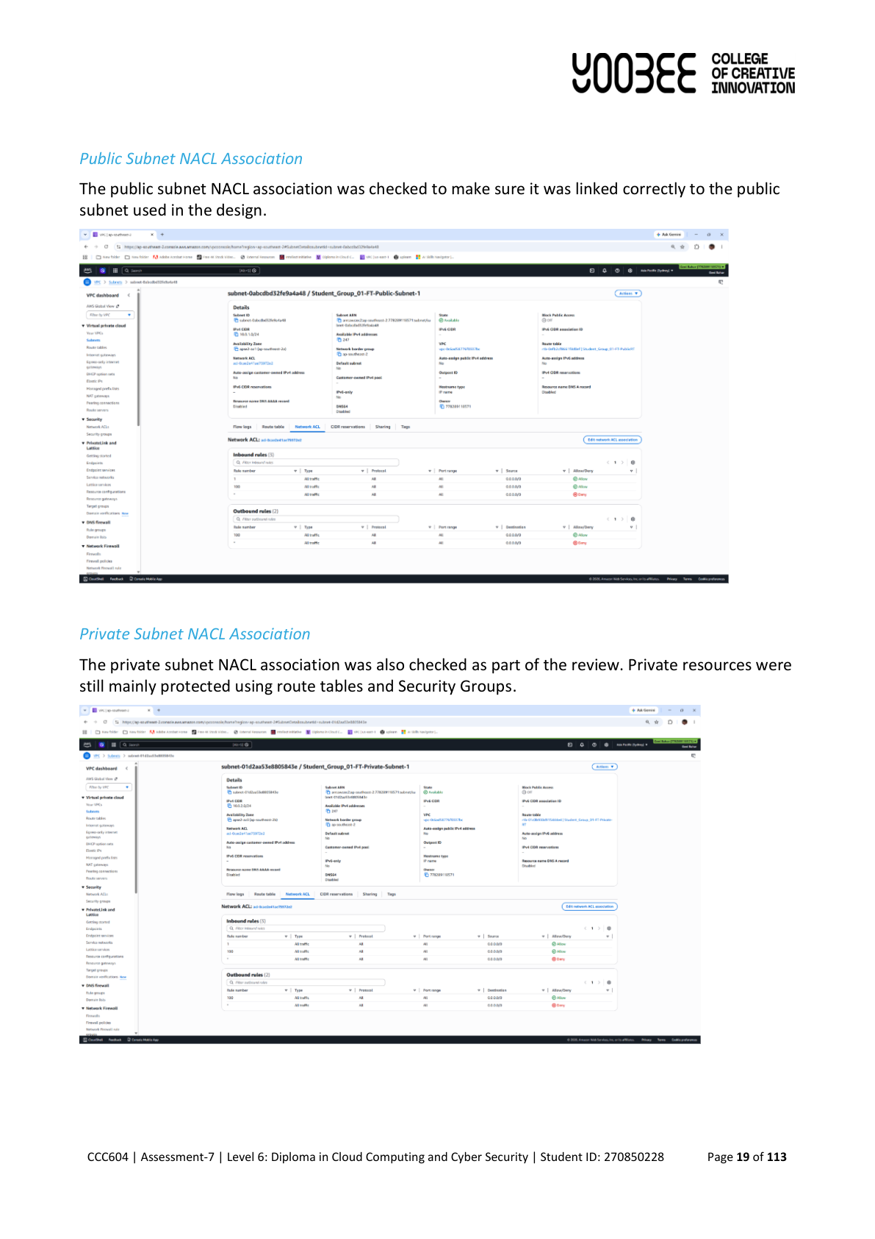
Security principles used in the design
Security design
Simple controls applied across the whole setup
Separate public-facing services from internal resources
Use IAM roles and RBAC/MFA instead of shared administrator access
Restrict management access through VPN or approved paths
Enable encryption for storage and HTTPS for web access
Use monitoring, logs and alerts to support troubleshooting
Use backup and snapshots for recovery from mistakes or failures
CCC604 Assessment 8 | Multi-Cloud Security Integration | 8
Notes:
Geni, 1 minute: Summarise the security approach before going into technical details. The key idea is layered security: network control, identity control, encryption, monitoring and backup. Mention that the Security Group issue later proves why these checks matter.

Slide 9
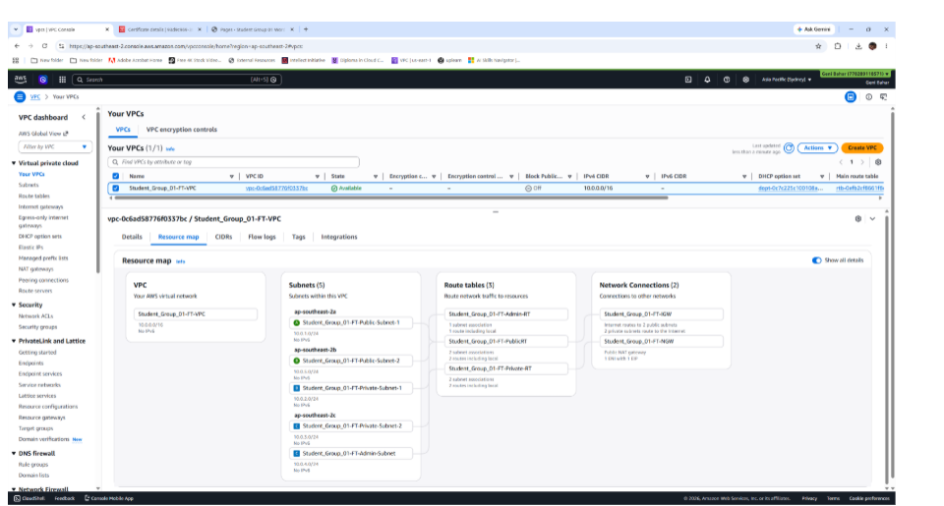
AWS network foundation
AWS implementation
VPC, subnets, route tables, Internet Gateway and NAT Gateway
Dedicated VPC created for the assessment resources
Public subnets for internet-facing components
Private subnets for internal application/database resources
NAT Gateway used for outbound access without direct inbound exposure
NACL reviewed; Security Groups used for detailed access control
CCC604 Assessment 8 | Multi-Cloud Security Integration | 9
Notes:
Geni, 1.2 minutes: Explain that the AWS implementation started with the VPC design. Public resources need internet access, but private resources should not be directly reachable. NAT Gateway helps private resources reach updates while avoiding public inbound access.

Slide 10
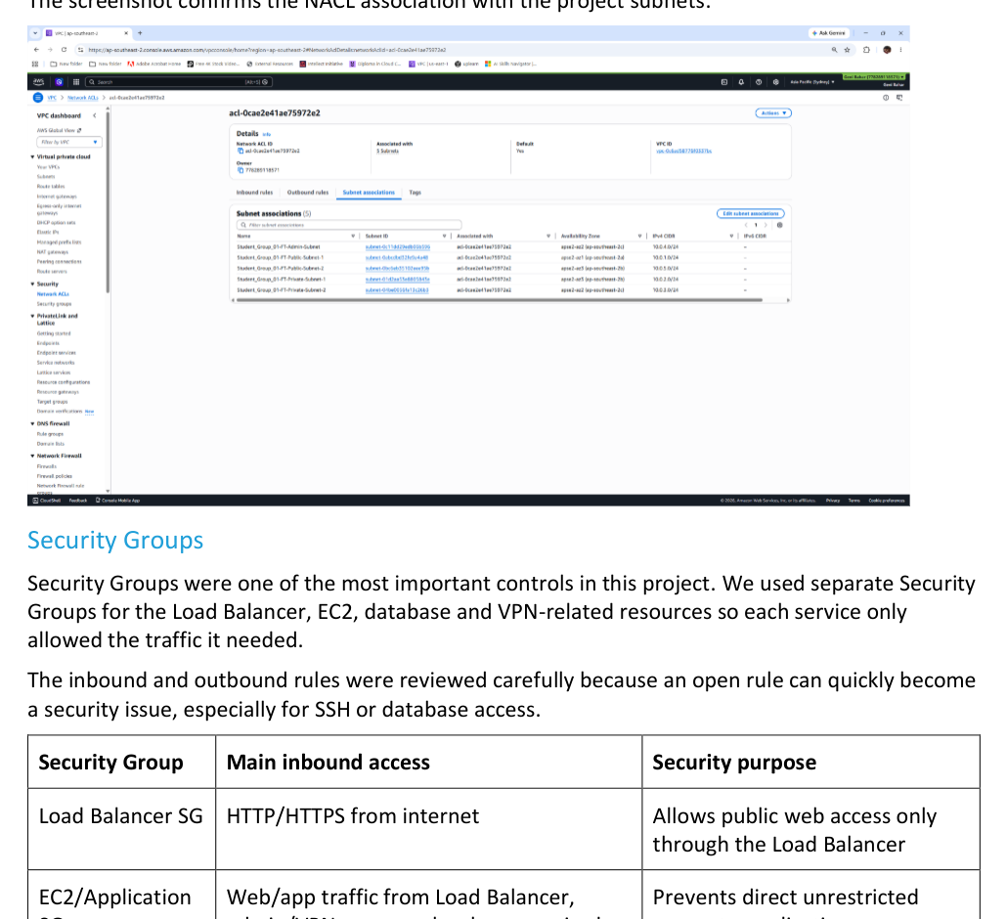
AWS access control
AWS security
Security Groups and IAM roles were the main AWS controls
Separate Security Groups for Load Balancer, EC2, RDS, VPN and FortiGate
Load Balancer allowed HTTP/HTTPS as the public entry point
RDS access restricted to application-side access only
IAM roles used instead of long-term access keys
EC2 and Lambda roles supported controlled S3 and snapshot access
CCC604 Assessment 8 | Multi-Cloud Security Integration | 10
Notes:
Geni, 1.2 minutes: Talk about the Security Group design and IAM. Emphasise that the team reviewed inbound rules carefully because an open SSH or database rule can quickly become a security issue. Mention IAM roles reduce the need to store keys.

Slide 11
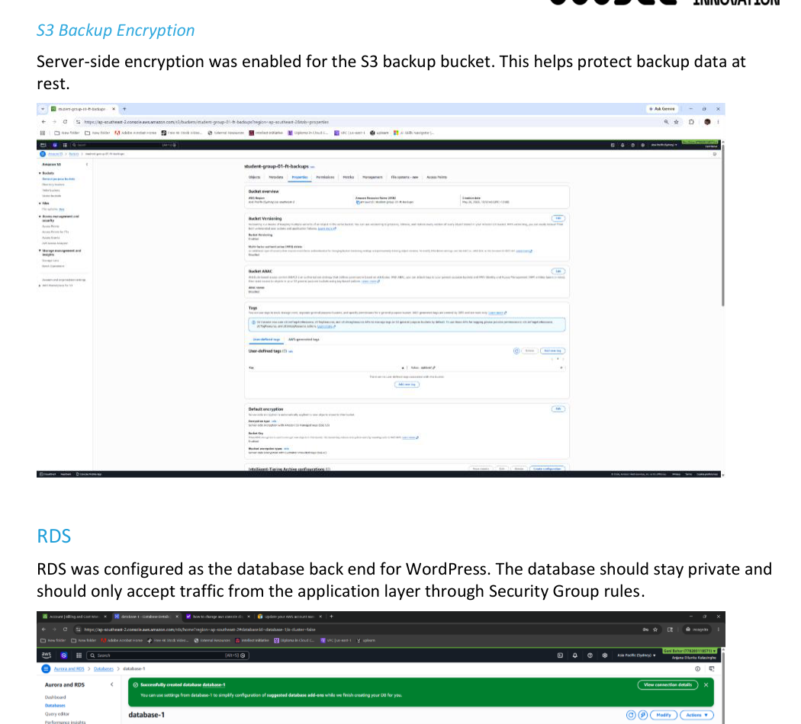
Data protection and recovery
AWS security
RDS, S3, KMS encryption and snapshots
RDS used as the WordPress database back end
Database kept private and controlled through Security Groups
S3 bucket used for backup-related storage
Server-side encryption enabled where possible
Snapshots used as recovery points for misconfiguration or deletion
CCC604 Assessment 8 | Multi-Cloud Security Integration | 11
Notes:
Geni, 1 minute: Explain the data protection choices. RDS stores the database, S3 stores backup-related data, and encryption protects data at rest. Snapshots are useful if something is misconfigured or deleted.

Slide 12
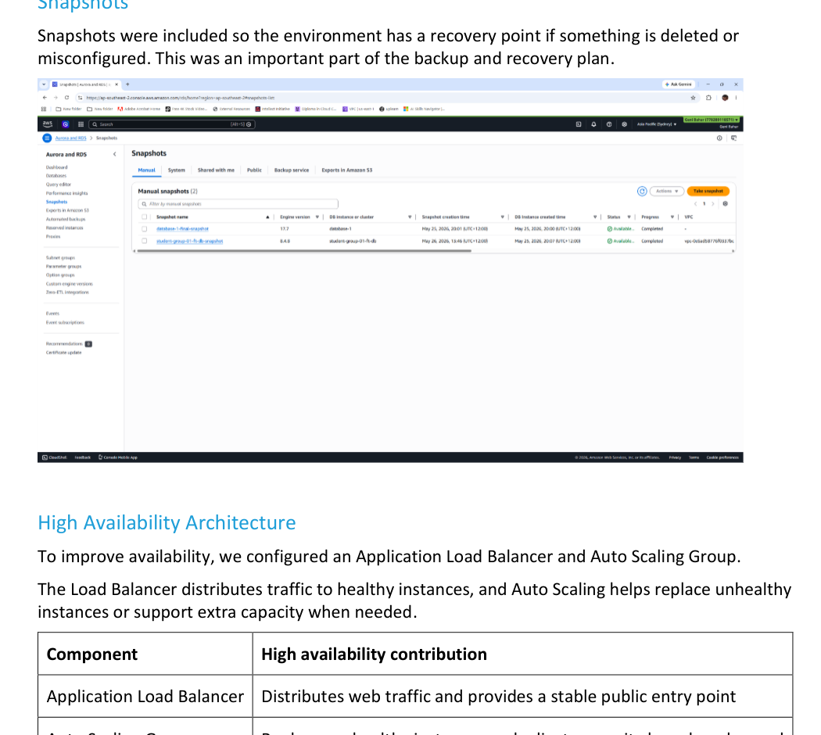
High availability design
AWS implementation
Application Load Balancer and Auto Scaling
Application Load Balancer provides a stable public entry point
Target Group checks instance health before traffic is sent
Auto Scaling Group can replace unhealthy instances
Multiple subnets support a more resilient layout
ACM/HTTPS protects public web access
CCC604 Assessment 8 | Multi-Cloud Security Integration | 12
Notes:
Geni, 1 minute: Explain how availability was improved. Instead of relying on one standalone instance, the Load Balancer and Auto Scaling Group support health checks and replacement. This makes the WordPress deployment closer to a real cloud design.

Slide 13
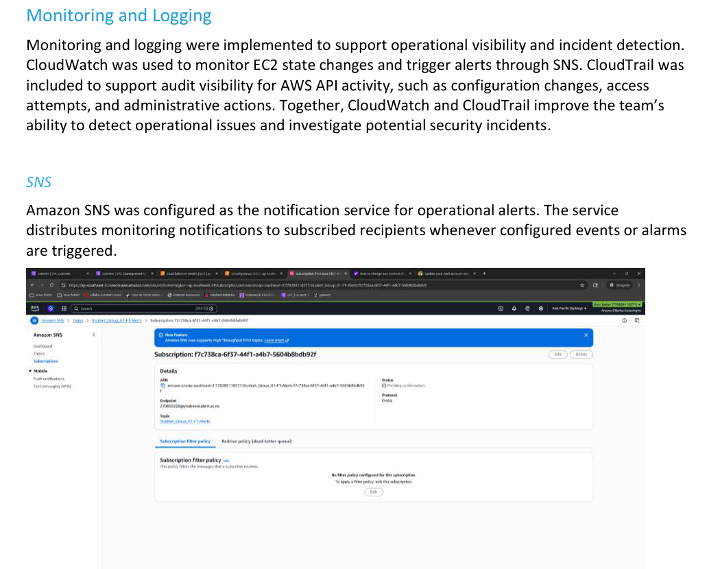
Monitoring and notifications
AWS security
CloudWatch, CloudTrail and SNS supported visibility
CloudWatch used for monitoring events and operational alerts
SNS configured for notification delivery
CloudTrail included for AWS API activity and configuration changes
Logs and alerts support troubleshooting and incident review
CCC604 Assessment 8 | Multi-Cloud Security Integration | 13
Notes:
Geni, 1 minute: Explain that monitoring is not only for uptime. CloudTrail helps with configuration change review, while CloudWatch/SNS helps detect operational events. This links directly to the incident analysis later.

Slide 14
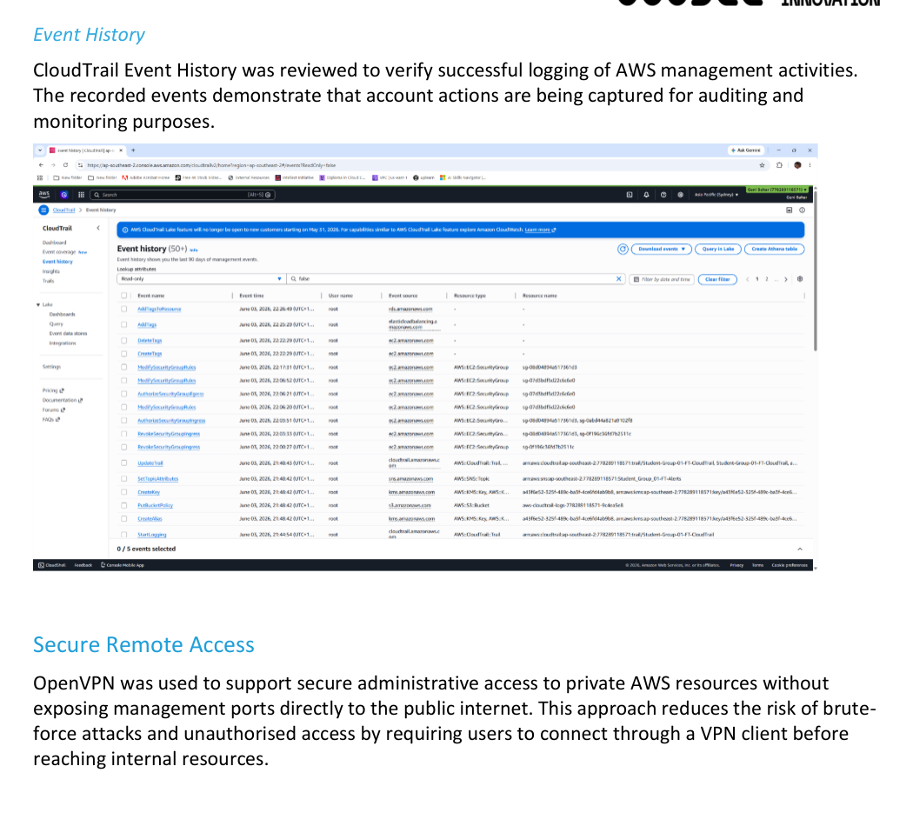
Secure remote access
AWS/Fortinet
OpenVPN and FortiGate reduced direct exposure
OpenVPN used to support private access paths
Management access should not rely on public SSH exposure
VPN/FortiGate controls help limit who can reach internal resources
This became important during the Security Group incident review
CCC604 Assessment 8 | Multi-Cloud Security Integration | 14
Notes:
Geni, 1 minute: Describe the purpose of OpenVPN and FortiGate from a practical perspective. The project wanted controlled management access rather than leaving private systems exposed to the internet.

Slide 15
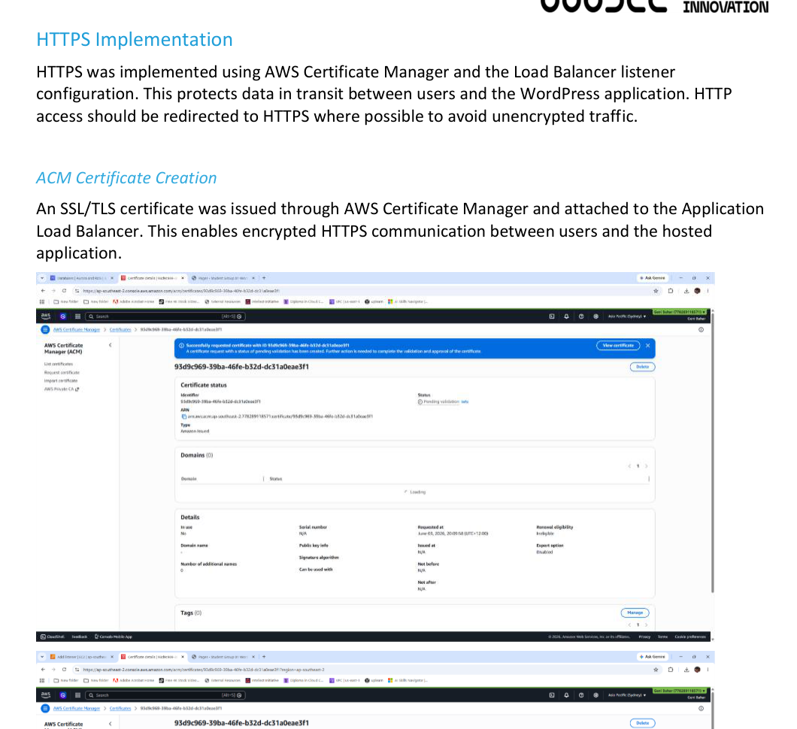
WordPress application and HTTPS
Application
Final workload and secure public access
WordPress was deployed as the main application workload
RDS supported the database back end
Load Balancer + ACM provided secure HTTPS access
Azure DNS was later used to resolve the public name to the AWS endpoint
CCC604 Assessment 8 | Multi-Cloud Security Integration | 15
Notes:
Geni, 1 minute: Explain that WordPress was the practical workload used to demonstrate the migration. The site, database, Load Balancer, HTTPS and DNS together prove that the architecture was not just theoretical.

Slide 16
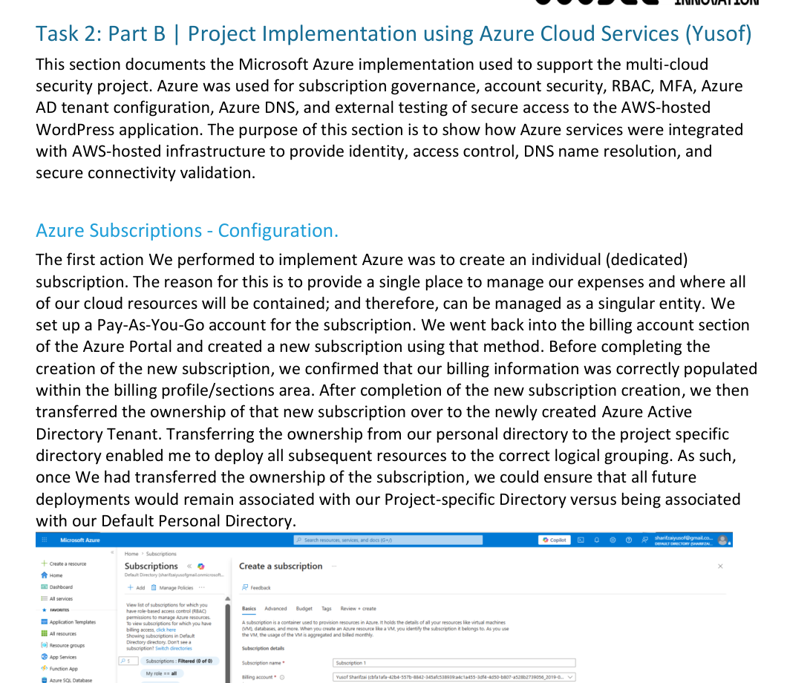
Azure implementation
Azure implementation
Subscription, Azure AD, RBAC, MFA and DNS
Azure subscription checked before deployment work
Azure AD tenant created for the project context
RBAC used to limit access by role
MFA added an extra layer of account protection
Azure DNS used as the public DNS integration point
CCC604 Assessment 8 | Multi-Cloud Security Integration | 16
Notes:
Yusof, 1.4 minutes: Explain the Azure responsibilities. Subscription validation came first. RBAC and MFA protected Azure access. Azure DNS was then used to connect the public domain side of the project to the AWS-hosted WordPress workload.

Slide 17
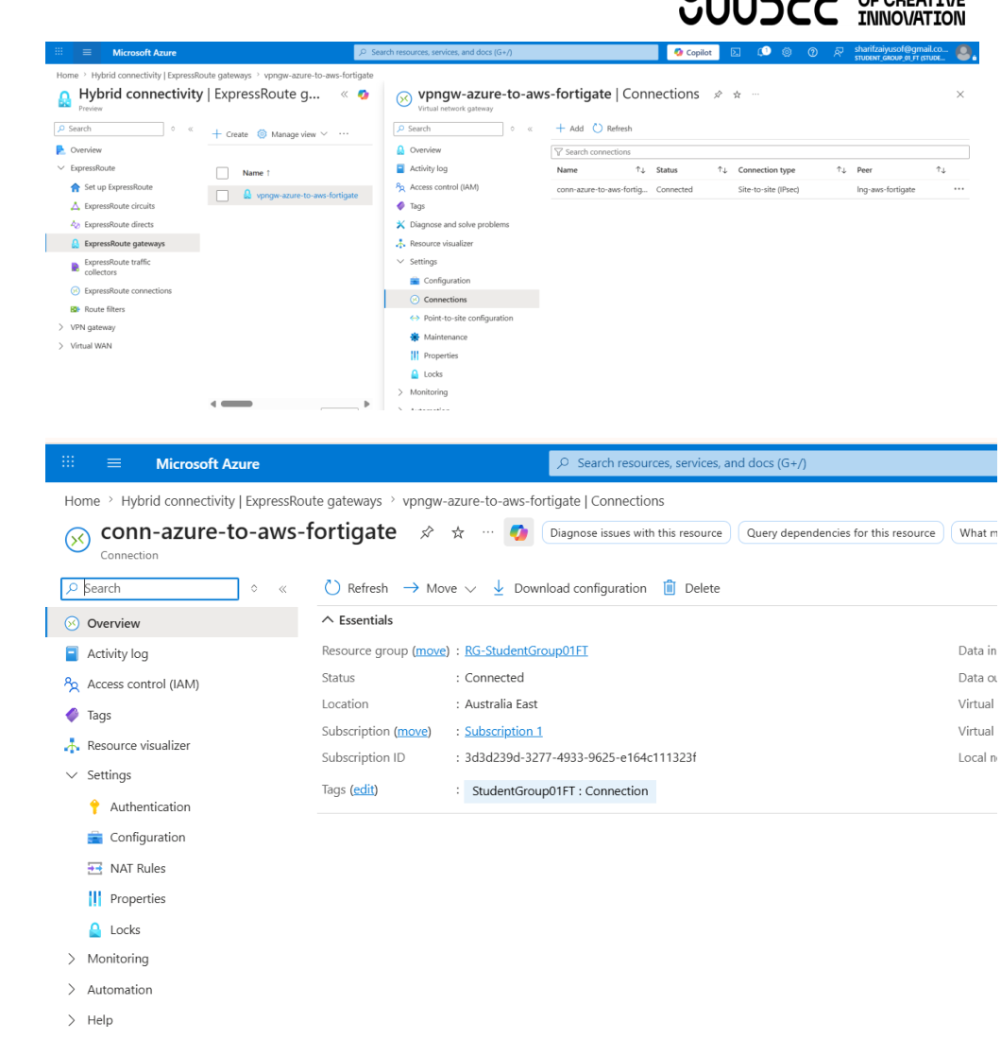
Azure DNS and access testing
Azure integration
AWS hosted the site; Azure DNS resolved the public name
Azure DNS records pointed users to the AWS load balancer endpoint
HTTPS testing confirmed secure public access
VPN client testing supported controlled access checks
This demonstrated that AWS and Azure were working together, not separately
CCC604 Assessment 8 | Multi-Cloud Security Integration | 17
Notes:
Yusof, 1.4 minutes: Explain the key integration result. The website was hosted in AWS, but the public DNS part was configured in Azure. The final test was secure HTTPS access through the Azure-managed DNS name.

Slide 18
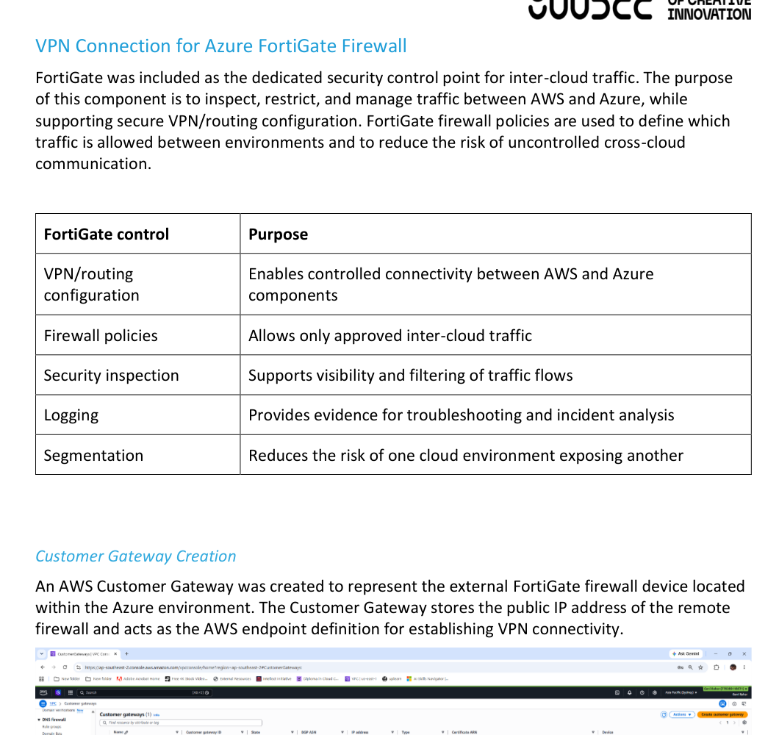
Fortinet security integration
Fortinet
Firewall and VPN controls for the multi-cloud design
FortiGate was included as the main firewall/security component
VPN and firewall policies helped control traffic paths
Fortinet evidence supports the multi-cloud security requirement
The project considered logging and traffic control as part of incident review
CCC604 Assessment 8 | Multi-Cloud Security Integration | 18
Notes:
Geni, 1.2 minutes: Explain Fortinet at a high level. FortiGate was included so the design did not rely only on AWS and Azure default controls. It supports firewall, VPN and traffic-control thinking between cloud environments.

Slide 19
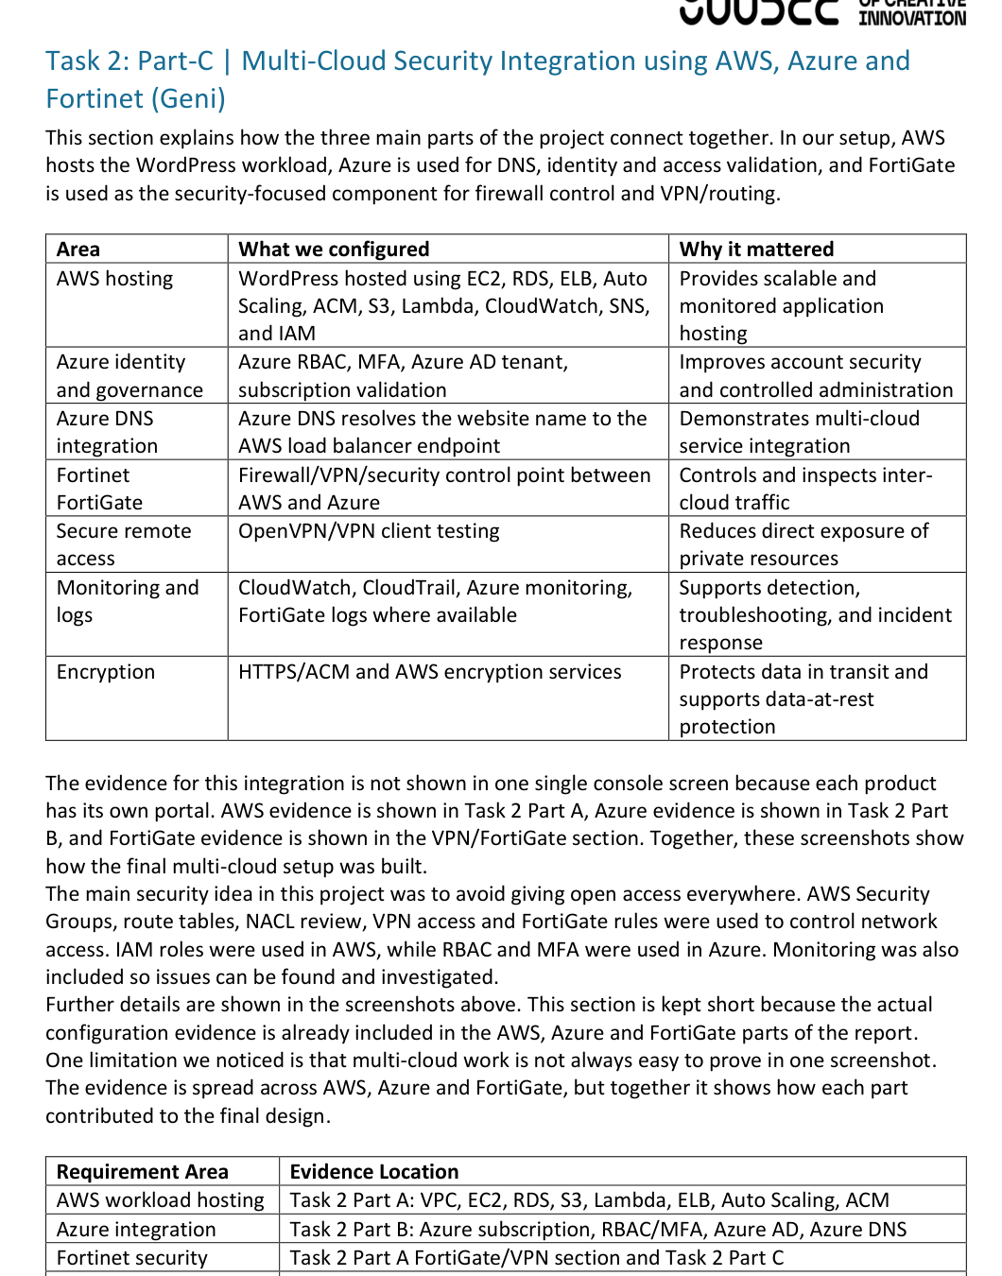
Multi-cloud integration summary
Integration
How the separate platforms worked as one design
AWS hosted WordPress, RDS, monitoring, backup and load balancing
Azure provided identity controls, DNS and external access testing
FortiGate supported firewall/VPN controls and traffic security
Evidence is spread across separate consoles because the platforms are separate
The final design linked access control, DNS, monitoring, backup and security together
CCC604 Assessment 8 | Multi-Cloud Security Integration | 19
Notes:
Geni, 1.2 minutes: Summarise the integration. Mention that because AWS, Azure and FortiGate are separate platforms, the proof appears across different screenshots. The integration is shown by how the services worked together in the final design.

Slide 20
Security control mapping
Security integration
Controls applied across AWS, Azure and Fortinet
AWS
AZURE
FORTINET
VPC and subnet separation
Security Groups and IAM roles
CloudWatch, CloudTrail, SNS
S3/RDS encryption and snapshots
Azure AD tenant
RBAC and MFA
Azure DNS records
HTTPS/VPN testing
FortiGate firewall/VPN
Traffic control policies
Logging review
Secure access path
Key message: the security design used layered controls instead of depending on one product or one cloud.
CCC604 Assessment 8 | Multi-Cloud Security Integration | 20
Notes:
Geni, 1 minute: This slide helps the audience see the security coverage quickly. Explain each platform’s job and emphasise layered controls. This is directly connected to Task 2 of Assessment 8.

Slide 21
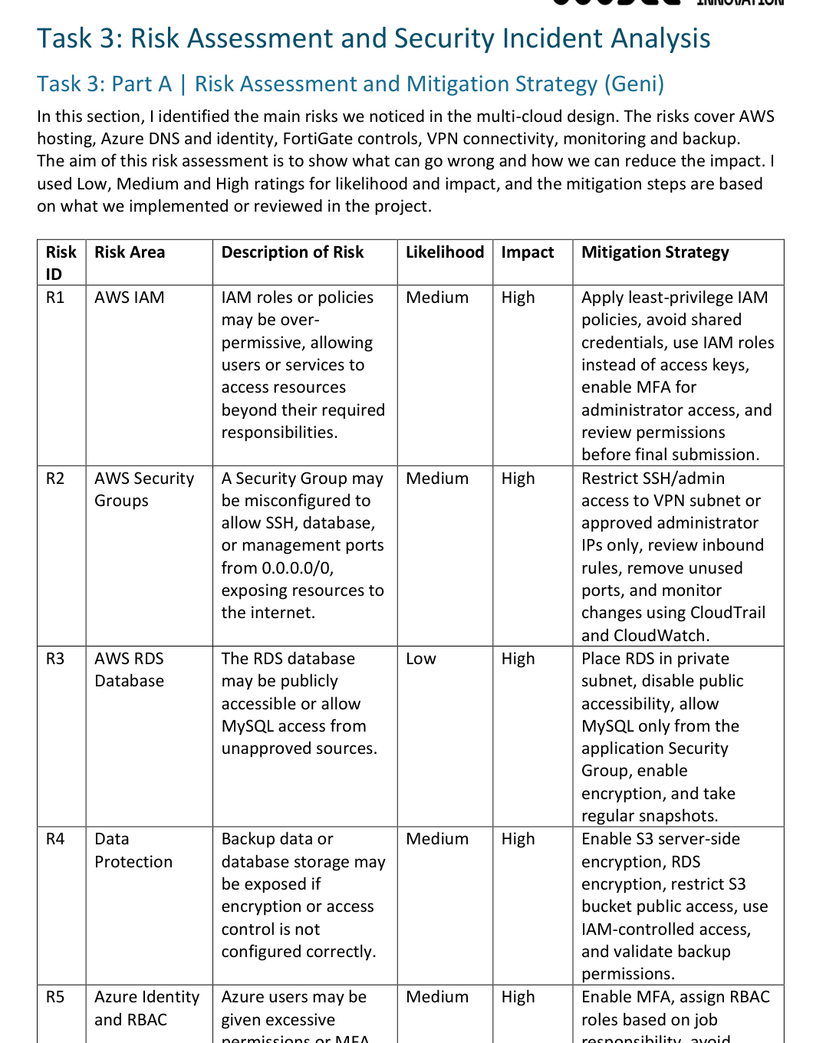
Risk assessment approach
Risk management
Focused on practical cloud mistakes and their impact
Risks were rated by likelihood and impact
Most risks were practical configuration issues, not complex attacks
Examples: IAM errors, public access exposure, DNS mistakes, VPN/FortiGate policy issues
Mitigations used MFA, least privilege, peer review, logging, testing and backup validation
CCC604 Assessment 8 | Multi-Cloud Security Integration | 21
Notes:
Hari, 1.2 minutes: Explain how the risk assessment was built. Keep it practical: small mistakes like wrong Security Groups, DNS records, or firewall policies can create big problems. Mention the risk table and mitigation strategies.

Slide 22
Top risks and mitigation examples
Risk management
What we considered most important
HIGH-RISK AREAS
MITIGATION ACTIONS
IAM or RBAC over-permission
Security Group allowing public SSH/database access
RDS or backup storage exposure
FortiGate policy or VPN routing mistake
Monitoring gaps during incident review
Use least privilege and MFA
Restrict inbound rules and review access paths
Keep database/private resources non-public
Review firewall/VPN rules before final submission
Use CloudTrail, CloudWatch, Azure Monitor and FortiGate logs
CCC604 Assessment 8 | Multi-Cloud Security Integration | 22
Notes:
Hari, 1.1 minutes: Walk through the major risks and mitigations. The aim is to show that the group thought about both security and operational risks. Keep the explanation short but clear.

Slide 23
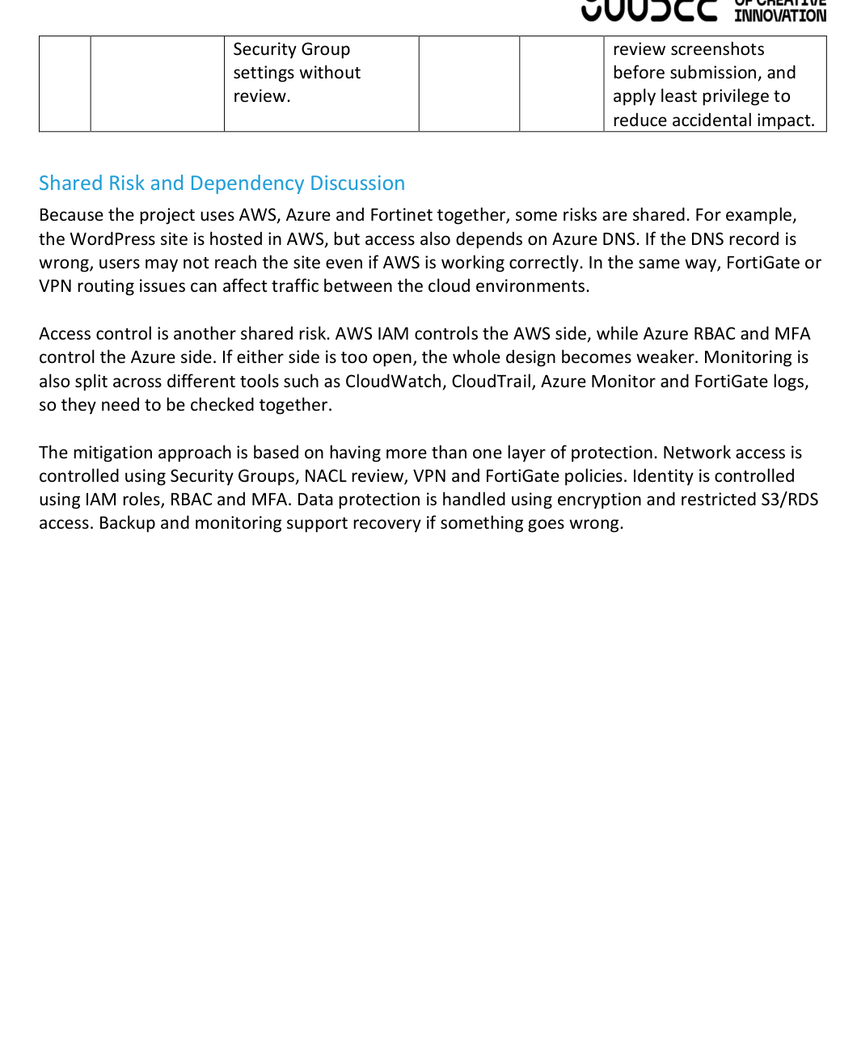
Security incident identified during testing
Incident analysis
EC2 Security Group allowed public SSH access
Issue found: SSH port 22 allowed from 0.0.0.0/0
Why it mattered: any public IP could attempt SSH connection
No confirmed unauthorised access; the issue was unnecessary exposure
Corrective action: restrict/remove public SSH and review access controls
CCC604 Assessment 8 | Multi-Cloud Security Integration | 23
Notes:
Hari, 1.3 minutes: Explain the incident in the same practical way as the report. Do not overstate it as a major breach. It was a configuration issue found during project testing. The risk was public SSH exposure, even with key-based authentication.

Slide 24
Incident response timeline
Incident analysis
How the issue was reviewed and corrected
1. IDENTIFY
2. CONFIRM
3. CORRECT
4. DOCUMENT
Security Group rule reviewed
Port 22 source: 0.0.0.0/0
Public SSH not required
VPN/FortiGate path preferred
Restrict/remove rule
Check related groups
Record lessons learned
Add prevention actions
CCC604 Assessment 8 | Multi-Cloud Security Integration | 24
Notes:
Hari, 1 minute: Use this slide to explain the timeline without reading every row. The key message is that the team identified, confirmed, corrected and documented the issue.

Slide 25
Monitoring and evidence used
Incident analysis
What would support checking and troubleshooting
AWS EVIDENCE
CROSS-CLOUD EVIDENCE
EC2 Security Group inbound rules
CloudTrail security group change activity
CloudWatch monitoring and alerts
EC2 system logs where available
FortiGate VPN/firewall policy and logs
Azure Monitor and Azure AD review
Azure DNS status and HTTPS testing
Final verification summary
CCC604 Assessment 8 | Multi-Cloud Security Integration | 25
Notes:
Hari, 1 minute: Explain that incident analysis needs evidence. In this project, some evidence was direct configuration evidence, while logs were identified as the correct places to review for future troubleshooting.

Slide 26
Lessons learned
Reflection
What the team would carry forward
Multi-cloud work is not just resource creation; services need to connect safely
Small cloud configuration mistakes can create major exposure
Security Groups, IAM/RBAC, DNS, VPN/firewall rules and monitoring must be reviewed together
Screenshots and documentation are important because they prove what was configured
Team communication helped keep AWS, Azure and Fortinet work aligned
CCC604 Assessment 8 | Multi-Cloud Security Integration | 26
Notes:
Geni/Yusof/Hari, 1 minute: Summarise the key learning. Keep it natural. The biggest lesson is that secure multi-cloud design depends on planning, access control, communication and review.

Slide 27
Conclusion
Close
A secure, documented and verified multi-cloud project
The project delivered a working AWS-hosted WordPress design
Azure provided identity, DNS and access-testing support
Fortinet added firewall/VPN security control to the design
Risk and incident analysis showed how configuration mistakes are handled
The final output demonstrates both technical security and team communication
CCC604 Assessment 8 | Multi-Cloud Security Integration | 27
Notes:
Geni/Yusof/Hari, 1 minute: Close the presentation. Emphasise that the group demonstrated the full lifecycle: planning, implementation, security integration, risk/incident handling and verification. Thank the audience.

Slide 28
Thank You
Student_Group_01-FT • Geni Bahar • Yusof Sharifzai • Hari Tamang
CCC604 Assessment 8 | Multi-Cloud Security Integration | 28

